Slide 1
CAS Applied Data Science
Module 3 –Machine Learning Application
Image classification in the CIFAR10 dataset
Frederic Bärtl, Nicolas Gaillard
12. November 2022, Bern

Slide 2
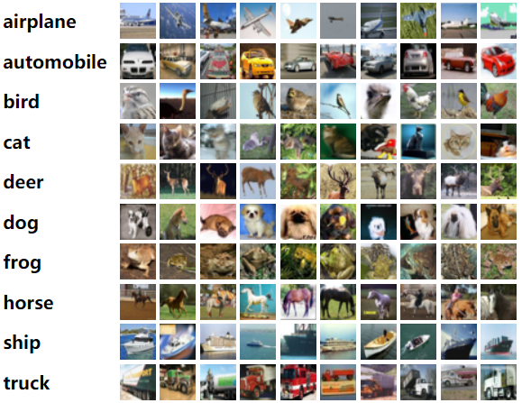
Data Analysis
Key points about the used data:
Dataset consists of 60000 images of 32x32 pixels
In all models, we split this into a training set of 50000 and a test set of 10000 images
Dataset is labeled and has 10 different categories (see on the right)

Slide 3
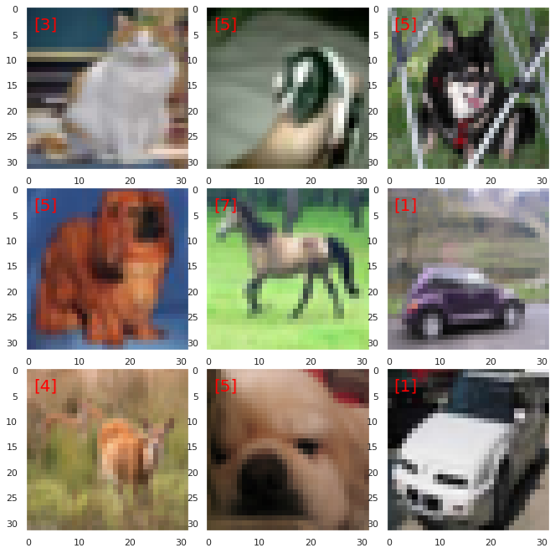
Data Analysis
Key points about the used data:
Due to the low resolution of the images, humans can derive the correct category in 94% of the cases
Thus to make a model that is better than the human eye, accuracy must be > 94 %
We try to achieve this with the “limited” models we are already familiar with after M3.

Slide 4
Supervised model application
Random forest decision tree classifier model
Logic: Image information has been stored in 1 dimension (32x32x3 = 3072)
Result:
We achieve a maximum accuracy of 0.453 (45 %) in our Test set (and 74% in the Training set)
Take aways:
We are unhappy with the performance of the model
We question the 29% difference between test and training set (we will discuss data augmentation)
N_est Setting | Max_depth setting | Accuracy Training set | Accuracy Test set
10 | 5 | 33% | 32%
100 | 100 | 42% | 39%
200 | 700 | 59% | 43%
500 | 5000 | 74% | 45%

Slide 5
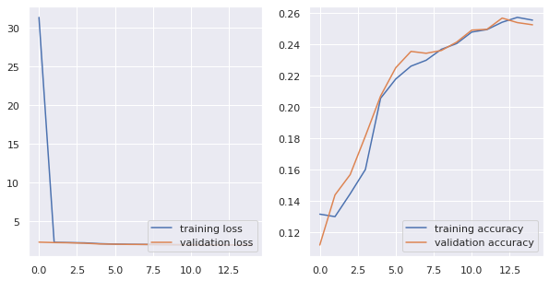
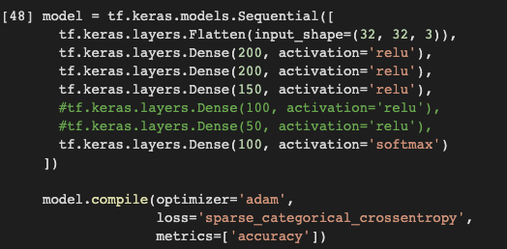
Unsupervised Learning application
We are trying to achieve better results by using USL:
We started by using a sequential model with 3 layers of Neural Networks
A standard model with limited layers and nodes is not superior to our OCR model

Slide 6
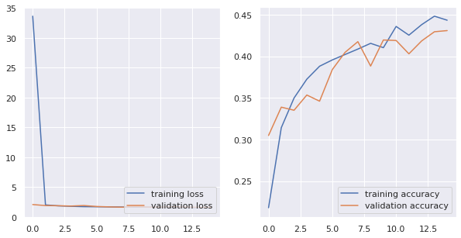
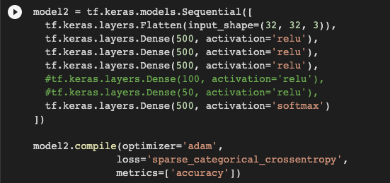
Unsupervised Learning application
First adjustment, we increased the amount of nodes:
We increased the nodes and kept the 3 layers of Neural Networks
More nodes result in substantially higher accuracy (43%)

Slide 7
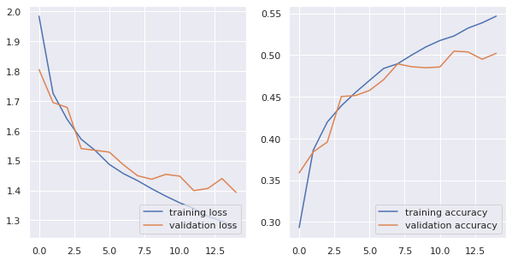
Unsupervised Learning application
Second adjustment, we normalized the image data:
We used the same sequential model with 3 layers of Neural Networks
Normalisation of the image information is crucial in increasing accuracy to > 50%

Slide 8
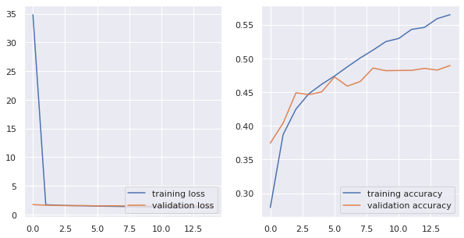
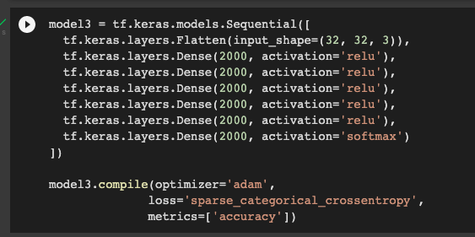
Unsupervised Learning application
Third adjustment, we increased nodes and layers: (data not normalized)
We used a sequential model with 5 layers of Neural Networks and more nodes
Performance does not increase and the accuracy is actually a bit lower than with the 3 layer model (approx. 49%)

Slide 9
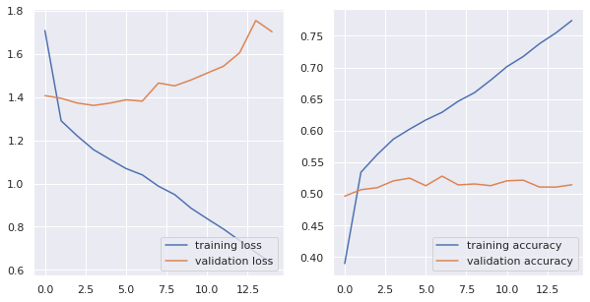
Unsupervised Learning application
Forth adjustment, we increased nodes and layers: (data normalized)
We used a sequential model with 5 layers of Neural Networks and more nodes
Performance does slightly increase and the accuracy is above 50% but overfitting (increasing loss).
Thus increasing the network will not help increasing the performance!

Slide 10
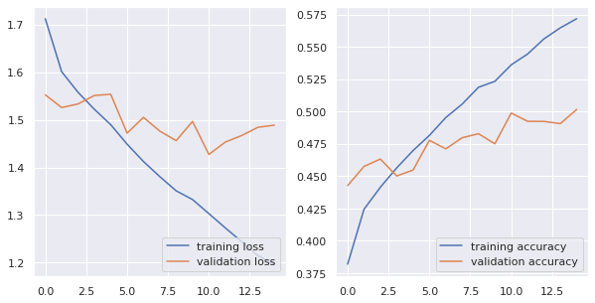
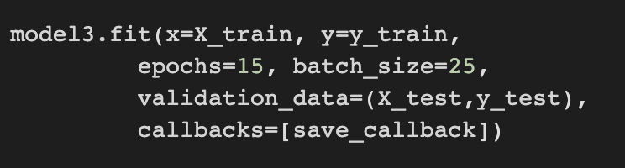
Unsupervised Learning application
Fifth adjustment, we decrease batch size (more images per epoch) : (data normalized)
Until now, we checked with batch-size 250 (200 datapoints per epoch)
No substantial change in the accuracy by decreasing batch size

Slide 11
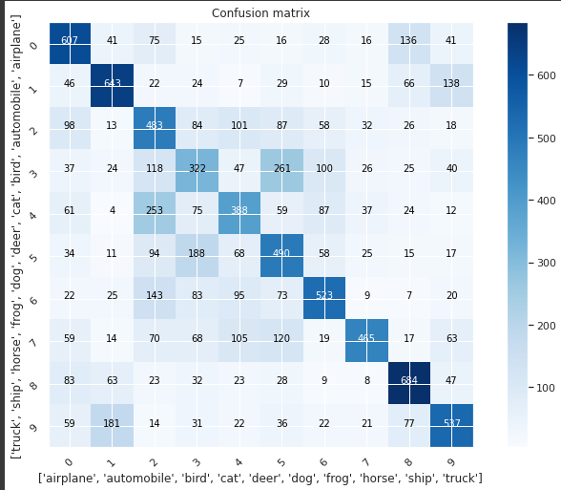
Unsupervised Learning application
What is the model getting wrong ?
The model is unsure about very specific categories
The main problem is around birds, cats and deer

Slide 12
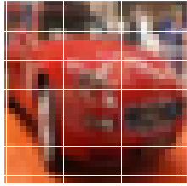
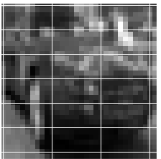
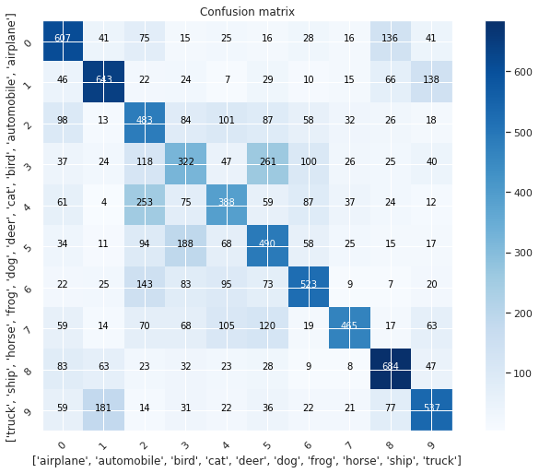
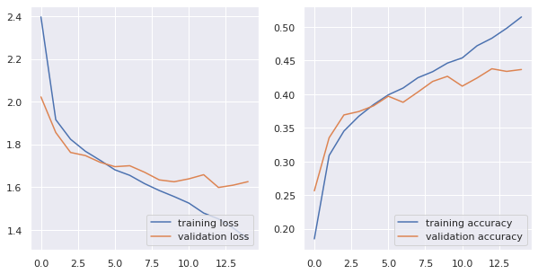
Unsupervised Learning application
Sixth adjustment, adjusting the images might help ? Gray Scale
Less image information (32x32x1 instead of 32x32x3) leads to lower performance of the model

Slide 13
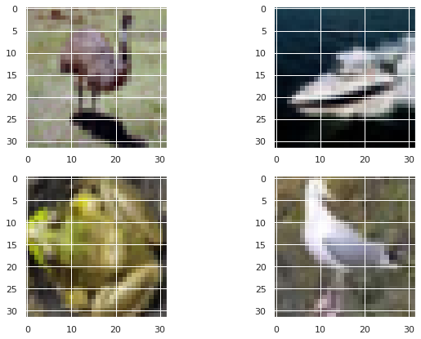
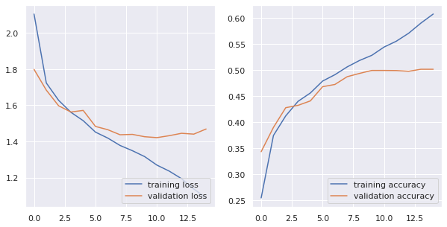
Unsupervised Learning application
Seventh adjustment: Random flipping for better training set
We randomly flipped 25 % of the images using “imageDataGenerator”
The idea is to have a more heterogeneous training set resulting in a higher accuracy in the test set
This image manipulation did not result in higher accuracy

Slide 14
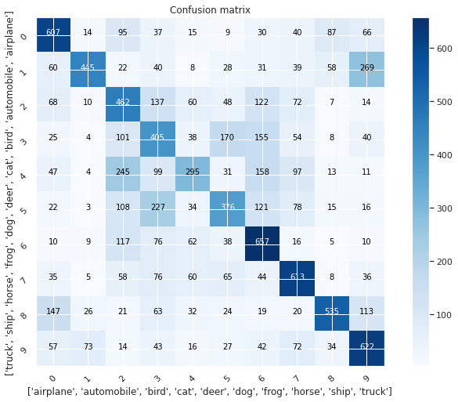
Unsupervised Learning application
Seventh adjustment: Random flipping for better training set
We see a strong difference in very specific categories: Flipped is superior with frogs and cats but more inaccurate on deer.

Slide 15
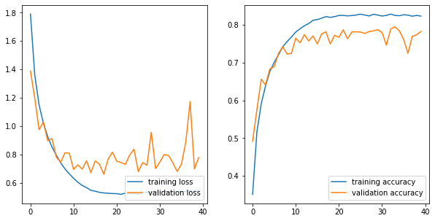
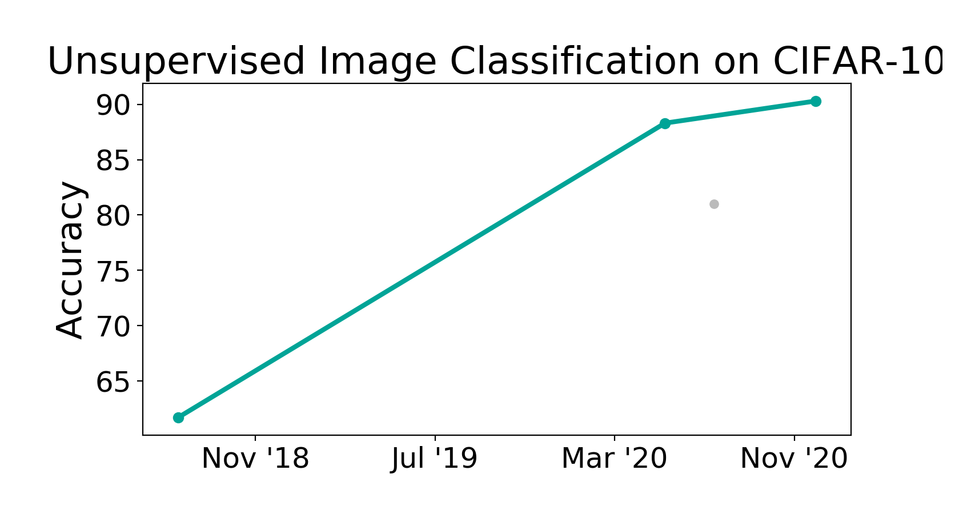
Summary of our ML application
Minimal goal:
Our unsupervised models outperform the supervised approach: 50 % vs. 45 %
How to get a better result ?
More sophisticated data augmentation:
Different zoom levels of the pictures
Different cut outs
Additional pixels added
Such technics are used when applying CNN
Short outlook into the Module 6:
What is the potential performance of a Convolution Neural Network:
”Rudimentary” CNN try by us: approx. 78% accurate
Best CNN model in 2022 reaches approx. 95%
The main problem is around birds, cats and deer

